Slide 1
Final Project : 460
Valley Crimes

Slide 2
Chontanat Suwan Geography 460 : Spatial Analysis Prof. Steven Graves, Ph.D.

Slide 3
Objectives
Analyzing a series of hypotheses of construction and interpret
Analyzing the pattern of crimes occurring in the San Fernando Valley by using statistical measures
Data Preparation
Clipped out all outlying violent crimes in the San Fernando Valley
Exported clipped data and other data to a local workspace.
Spatially join violent crimes and liquor stores to census tracts
Symbolize entire meaning symbols

Slide 4
Statistical Measurements
Descriptive Statistics – Mean, Median, Standard Deviation
Descriptive Spatial Statistics – Mean Center, Median Center
Sampling - random, stratified
Inferential Statistics – Z-test, ANOVA
Goodness of Fit Testing – Komologrov-Smirnov
Inferential Spatial Statistics – Nearest Neighbor Analysis, Moran’s I
Predictive Statistics – Correlation, Regression

Slide 5
Collect Events
Collect Event Tool combines coincident points and have the exact same X and Y centroid coordinates. It creates a new Output Feature Class containing all of the unique locations found in the Input Feature Class. It then adds a field named ICOUNT to hold the sum of all incidents at each unique location.
The result shows the coincident points occur repeatedly on the east of San Fernando Valley. This can be concluded that crimes are clustered in these areas

Slide 6
Collect Events

Slide 7
Inferential Statistics
Nearest Neighbor analysis, Moran's I

Slide 8
Average Nearest Neighbor
Calculates a nearest neighbor index based on the average distance from each feature to its nearest neighboring feature.
The z-score and p-value results are measures of statistical significance which tell if to reject the null hypothesis. For the Average Nearest Neighbor statistic.
If the index is lower than 1, the pattern exhibits clustering, or if the index is higher than 1, the trend is toward dispersion.
Hypothesis
If crimes in San Fernando Valley are clustered, then P-value would be close to zero, and Z-value will be less than -1.65 (2-tailed)

Slide 9
Procedure : Average Nearest Neighbor
In order to answer if are crimes clustered in the San Fernando Valley. Average Nearest Neighbor is used
Running the tool and interpret the results
The result indicates the crimes pattern is strongly clustered, since the Z-value is negatively huge value (below -1.65) and P-value is obviously close to zero.

Slide 10
Average Nearest Neighbor

Slide 11
Moran’s I
Moran’s I calculates a z-score and p-value to indicate whether or not you can reject the null hypothesis, measures spatial autocorrelation based on feature locations and attribute values using the Global Moran's I statistic.
If Z-score is greater than +1.96 (right tail), then P-value is small, or less than 1 percent chance of making type l error.
Moran’s I : Black Neighborhood and Hispanic Neighborhood.

Slide 12
Moran’s I : Black Neighborhood
Statistical results shows Moran index, Z-score and p-value are 0.38, 11.01 and very close to zero respectively. They indicate that the area pattern is much clustered. Moran’s index is close to 1 indicates clustering, Z-score is over the critical value at 1.96 (right tail) and falls within rejection area (difference). P-value is very small, or less than 1 percent of variable 1 equals to variable 2, or 1 percent chance of making type l error. LINK
In conclusion, comparing crimes (Collected Counts) with black neighborhood can tell that crimes seem clustered and occur in the area where the a number of black people live, especially in the east of the valley.

Slide 13
Moran’s I : Black Neighborhood

Slide 14
Moran’s I : Hispanic Neighborhood
Moran’s Index value is 0.65 indicates clustering and P-value and very close to zero which highly significant tendency toward clustering between above average (red) and below average (blue) areas. On the right, statistical results shows Moran index, Z-score and p-value are 0.65, 18.25 and very close to zero respectively. They indicate that the area pattern is totally clustered. Moran’s index is close to 1 indicates clustering, Z-score is over the critical value at 1.96 (right tail) and falls within rejection area (difference LINK
Thus, comparing crimes (Collected Counts) with Hispanic neighborhood illustrates the crimes are clustered and occur in the areas the high density of Hispanic people are settled.

Slide 15
Moran’s I : Hispanic Neighborhood

Slide 16
Descriptive Spatial Statistics
Mean Center, median center

Slide 17
Mean Center
The mean center is a point constructed from the average x and y values for the input feature centroids and calculated based on either Euclidean or Manhattan distance require projected data to accurately measure distances.
The result shows the mean center located almost in the middle of the San Fernando Valley. It caused by the number of crimes on the east, otherwise outliers; implies where the concentrated area is.

Slide 18
Mean Center

Slide 19
Median Center
The Mean Center and Median Center are measures of central tendency and Identifies the location that minimizes overall Euclidean distance to the features in a dataset.
The result shows

Slide 20
Median Center

Slide 21
Standard Deviational Ellipse
Measures whether a distribution of features exhibits a directional trend within 1-standard deviation (whether features are farther from a specified point in one direction than in another direction). Feature geometry is projected to the output coordinate system prior to analysis.
Elliptical polygons indicates crimes are concentrated in east to west direction caused by outliers in Canoga Park area and others in Sunland area. Thus, the trend of crimes could have more chance to elongate along west direction, since there is a natural barriers, hills, on the east.

Slide 22
Standard Deviational Ellipse

Slide 23
Standard Distance
Measures the degree to which features are concentrated or dispersed around the geometric mean center. Provides a single summary measure of feature distribution around their center, each circle polygon is drawn with a radius equal to the standard distance.
The radius is 9.5 km. from the center and 384 out of 683 or 68% crimes fall within this circle. In this instance, the crimes are concentrated and over a half of crimes occurred within 9-10 km.

Slide 24
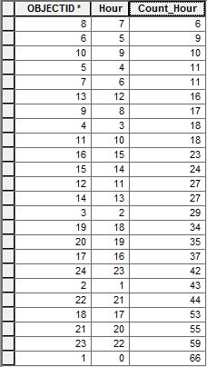
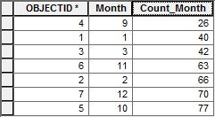
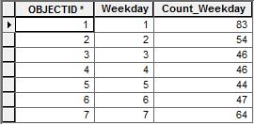
Standard Distance
These tables on the right represent collected and counted data in the violent crimes dataset; filtered by Standard Distance to analyze when the crimes most occur by analyzing the greatest number in months, weekdays and hours. According to the tables, the crimes most occur in October, on Monday and around midnight(the blue boxes). These could be used to narrow down areas and time that crimes would occur. Notice that the highest number of crime is not in December.

Slide 25
Standard Distance

Slide 26
Sampling
Random, Stratified

Slide 27
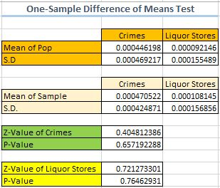
Random
Sampling is used to compare a mean from a random sample to the mean of a population.
Critical Z score values when using a 95% confidence level are -1.96 and +1.96 standard deviations.
Hypothesis : If Z score is between +/-1.96, then the means are not different and the null hypothesis would not be rejected.

Slide 28
Random
Crime Rates : Z score of the sample mean of crime rates is 0.40 which falls within the critical area. P-value is 0.65 or 65% of confidence of the null hypothesis. It can be inferred the sample and population means of random crime rates are not different, and the null hypothesis should not be rejected.
Liquor Stores : Z score is 0.72 and P-value is 0.76 can be interpreted that Z score is in the critical area, +/-1.96, and P-value is 76% sure (Type I Error) that rejecting the null hypothesis is incorrect; would not reject the null hypothesis.

Slide 29
Stratified
the process of dividing members of the population into homogeneous subgroups before sampling.
Results : The Z-value of crimes is 1.17 and P-value is 0.87 represent the population mean and the sample mean came from the same population, since Z-value falls within +/-1.96 as well as P-value shows 87% trust in the null hypothesis. In this instance, should not reject the null. On the other hand, Z-value and P-value of liquor stores indicates differently, merely 33% of confidence in the null

Slide 30
Inferential Statistics
Z-test, anova

Slide 31
Goodness of Fit Testing
Kolmogorov-Smirnov Goodness of fit test

Slide 32
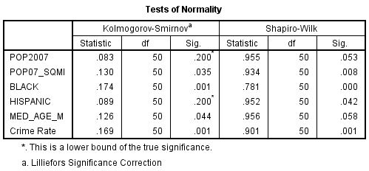
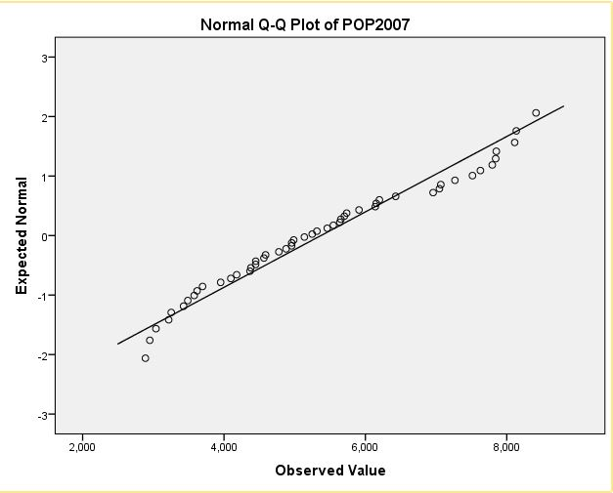
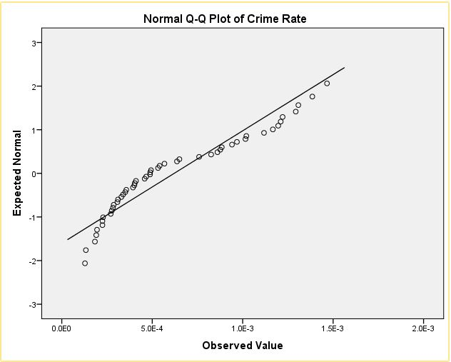
Kolmogorov-Smirnov
K-S can be used to compare a sample with a reference probability distribution (one-sample K–S test), quantifies a distance between the empirical distribution function of the sample and the cumulative distribution function of the reference distribution. P-value is close to 1 indicates “Very similar”, close to 0 indicates “Very different”.
if P is small, close to ZERO, then Reject the null hypothesis.
Results : The table shows K-S test of normality. The significant values which illustrate 0.20 meet normality. Other values which lower than 0.05 are not normal. For example, the Q-Q plot of POP 2007 shows a normality between expected and observed values, meanwhile Crime Rate does not.

Slide 33
Predictive Statistics
regression

Slide 34
Conclusion

Slide 35
A new crime station possibility
According to question three, opening a new rapid-response crime station which focus on Assault with Deadly Weapons. After running Mean Center Tool, Collect Event Tool and Standard Deviational Ellipse Tool. The findings illustrate that the mean is in the exact location when other crimes combined.
The location that would be proper to settle a new rapid-response crime station might be located in 64 square miles within the circle, especially on the east of the circle where the number of crime occurred repeatedly at the exact same locations.

Slide 36
Deathly Weapons Crimes

Slide 37
References
http://resources.arcgis.com/en/help/main/10.1/index.html#//005p00000008000000
http://resources.esri.com/help/9.3/arcgisengine/java/gp_toolref/spatial_statistics_tools/directional_distribution_standard_deviational_ellipse_spatial_statistics_.htm
http://resources.esri.com/help/9.3/arcgisengine/java/gp_toolref/spatial_statistics_tools/standard_distance_spatial_statistics_.htm
Notes:
----- Meeting Notes (12/6/13 22:59) -----
Hey guy

